Slide 1

Reduced specific absorption rate compact flexible monopole antenna system for wearable wireless communication
Department of Electronics and Communication Engineering
Submitted by:
Under the guidance of
Ms. R. Tejaswini
N Hema Anantha Durga Vara Prasad | 322103312136
N P Harshavardhan | 322103312135
P Satya Sathvik | 322103312167
P Akhil Rahul | 322103312146

Slide 2
Contents
Abstract
Objectives
Literature Survey
Software Used
Proposed Design
Radiation Patterns
Future scope
Results & Conclusion
Comparison Table
References

Slide 3
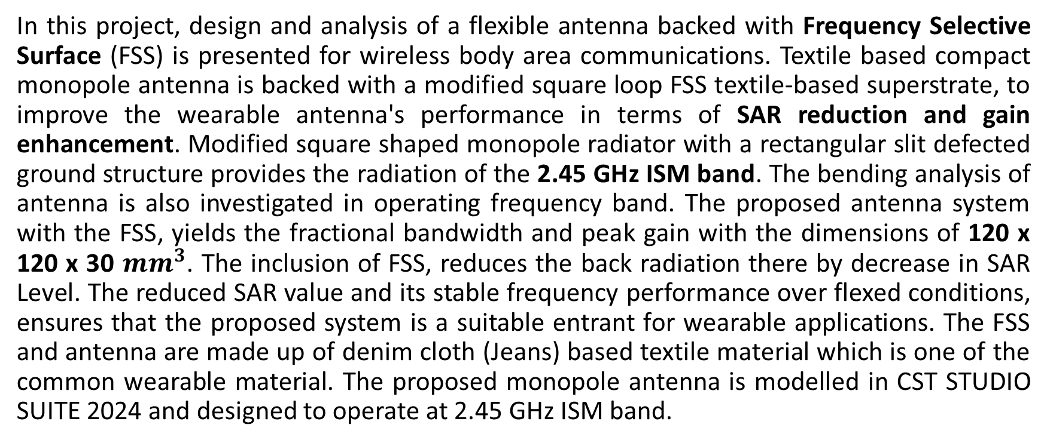
Abstract
In this project, design and analysis of a flexible antenna backed with Frequency Selective Surface (FSS) is presented for wireless body area communications. Textile based compact monopole antenna is backed with a modified square loop FSS textile-based superstrate, to improve the wearable antenna's performance in terms of SAR reduction and gain enhancement. Modified square shaped monopole radiator with a rectangular slit defected ground structure provides the radiation of the 2.45 GHz ISM band. The bending analysis of antenna is also investigated in operating frequency band. The proposed antenna system with the FSS, yields the fractional bandwidth and peak gain with the dimensions of 120 x 120 x 30 ${mm}^{3}$. The inclusion of FSS, reduces the back radiation there by decrease in SAR Level. The reduced SAR value and its stable frequency performance over flexed conditions, ensures that the proposed system is a suitable entrant for wearable applications. The FSS and antenna are made up of denim cloth (Jeans) based textile material which is one of the common wearable material. The proposed monopole antenna is modelled in CST STUDIO SUITE 2024 and designed to operate at 2.45 GHz ISM band.

Slide 4
Objectives
To design a compact, flexible textile-based monopole antenna operating at the 2.45 GHz ISM band for wearable WBAN applications
To reduce Specific Absorption Rate (SAR) significantly when the antenna is placed close to the human body by integrating a Frequency Selective Surface (FSS) reflector

Slide 5
Literature Survey
R.No | Title | Authors | Summary
[1] | Dual-band textile AMC integrated monopole antenna for SAR reduction | Yotrawee Hengroemyat, Wanwisa Thaiwirot, Prayoot Akkaraekthalin, Akkarat Boonpoonga and Nonchanutt Chudpooti | Flexible dual-band textile antenna (2.4/5.2 GHz) with AMC reflector improves gain, bandwidth, and lowers SAR; suitable for wearable health systems.
[2] | Compact wideband implantable antenna for wireless capsule endoscopy application in the 2.45 GHz ISM band | Archana Mohan and Niraj Kumar | Compact implantable antenna for 2.45 GHz uses slots, shorting pin, and DGS to improve bandwidth, gain, and SAR safety for capsule endoscopy and WBAN use.

Slide 6
[3] | A Comprehensive Review and Analysis of the Design Aspects, Structure, and Applications of Flexible Wearable Antennas | Sunaina Singh, Ranjan Mishra, Ankush Kapoor and Soni Singh | Review of wearable antennas covers materials, feeding, SAR reduction, and performance under bending/on-body, aiding IoT healthcare communication systems.
[4] | Terahertz dual-band antenna design with improved performances using FSS-based metasurface concept for wireless applications | Youssef Amraoui, Imane Halkhams, Rachid El Alami, Mohammed Ouazzani Jamil and Hassan Qjidaa | Dual-band THz patch antenna with FSS metasurface improves bandwidth, gain, and matching, enabling stable high-speed 6G communication and sensing systems.
[5] | Development of flexible durable multi-slotted antenna for wearable applications | Kummaramsetty Sainath, Shine Let Gunamony, Wahaj Abbas Awan, Navin M. George, Majjiga Deva Sindhu, Fahad N. Alsunaydih and Khaled Alhassoon | Flexible multi-slotted wearable antenna using CPW improves bandwidth, gain, and SAR safety, maintaining stable performance under bending for WBAN use.

Slide 7
[6] | On-Body Reduced Size AMC Design for Lowering Specific Absorption Rate in Wearable Antenna Application | Biragathis Babu, DiviyaDevi Paramasivam, Raimi Dewan, Noor Asmawati Samsuri and Nazirah Othman | Compact AMC-backed wearable antenna reduces SAR, improves gain and matching, and ensures stable performance under bending for safe WBAN use.
[7] | Textile Antenna with Dual Bands and SAR Measurements for Wearable Communication | Mahmoud A. Abdelghany, Mohamed I. Ahmed, Ahmed A. Ibrahim, Arpan Desai and Mai F. Ahmed | Dual-band textile antenna with CPW feed ensures stable gain, bandwidth, and SAR safety, maintaining performance under bending for WBAN healthcare use.
[8] | Wearable Textile Antenna on Jean Substrate for On-Body Wireless Communication Applications | Meena Kumari Mulaparti and U.V. Ratna Kumari | Jean-based textile antenna with CPW feed offers stable gain, matching, and low SAR, maintaining performance under bending for WBAN and healthcare use.

Slide 8
[9] | Engineering planar antenna using geometry arrangements for wireless communications and satellite applications | Hesham A. El-Hakim and Hesham A. Mohamed | Triple-band microstrip antenna (2.45, 6, 14 GHz) offers stable gain, improved bandwidth, and return loss, supporting WiMAX, WLAN, and radar systems.
[10] | Multiband and Low-Specific Absorption-Rate Wearable Antenna With Low Profile Based on Highly Conductive Graphene Assembled Film | Yang Xiao, Haoran Zu, Rongguo Song, Yitong Xin, Yueyue Xi, Guan Long Huang, Bian Wu and Daping He | Low-profile graphene wearable antenna on PDMS offers multiband operation, stable gain, flexibility, and reduced SAR for safe WBAN biomedical use.
[11] | Compact conformal tattoo-polymer antenna for on-body wireless power transfer | Xi Liang Chang, Pei Song Chee, Eng Hock Lim | Compact tattoo-polymer antenna on PDMS enables flexible, low-SAR wireless power transfer with stable performance for wearable WBAN devices.

Slide 9
[12] | Flexible and frequency reconfigurable CPW-fed monopole antenna with frequency selective surface for IoT applications | Ahmed A. Ibrahim, Hesham A. Mohamed, Mahmoud A. Abdelghany, Emad Tammam | Flexible CPW-fed monopole with FSS offers multiband IoT operation, improved bandwidth, gain, and low SAR, maintaining stable performance under bending.
[13] | A monopole antenna with cotton fabric material for wearable applications | Ayman Ayd R. Saad, Walaa M. Hassan, Ahmed A. Ibrahim | Cotton-based wearable monopole with AMC reduces SAR, improves matching and gain, and ensures stable performance under bending for WBAN healthcare use.
[14] | Design and Analysis of a Compact Dual-Band Wearable Antenna for WBAN Applications | Umar Musa, Shahraf Mhd Shah, Huda A. Majid, Ismail Ahmed Mahadi, Mohamad Kamal A. Rahim, Muhammad Saad Yahya | Compact dual-band wearable antenna ensures stable gain, matching, and low SAR, maintaining reliable performance under bending for WBAN biomedical use.

Slide 10
[15] | Bandwidth and Gain Enhancement of a CPW Antenna Using Frequency Selective Surface for UWB Applications | Musa Hussain, Md. Abu Sufian, Mohammed S. Alzaidi, Syeda Iffat Naqvi, Niamat Hussain, Dalia H. Elkamchouchi, Mohamed Fathy Abo Sree, Sara Yehia Abdel Fatah | CPW-fed UWB antenna with FSS improves bandwidth, gain, and efficiency, ensuring low SAR and stable performance for WBAN and imaging systems.
[16] | A Novel Compact Ultra-Wideband Frequency-Selective Surface-Based Antenna for Gain Enhancement Applications | Iftikhar Ud Din, Waheed Ullah, Nisar Ahmad Abbasi, Sadiq Ullah, Waleed Shihzad, Bilawal Khan, Dushantha Nalin K. Jayakody | Compact UWB monopole (3–12 GHz) with 6×6 FSS boosts gain from 3 to 8.1 dB, improving efficiency and directivity for wireless applications.
[17] | FDTD-based SAR calculation of a wearable antenna for wireless body area network devices | Hüseyin Şerif Savcı, Fatih Kaburcuk | FDTD-based SAR method accurately evaluates wearable antennas near tissues, improving safety, matching, and WBAN performance through validated modeling.

Slide 11
[18] | A Soft Surface Based Low Profile Wearable Antenna for Biomedical Telemetry | Devendra Kumar, Dhirendra Mathur | Low-profile 5.8 GHz wearable antenna offers flexible design, stable gain, good matching, and low SAR, ideal for biomedical telemetry and monitoring systems.
[19] | Triple Band Textile Array Antenna with Enhanced Gain and Low SAR for Off Body Communication Applications | VSD Rekha, M. Padmanabharaju, B. T. P. Madhav, S. S. Mohan Reddy | Triple-band wearable patch array (ISM, LAES, X-band) boosts gain and efficiency with low SAR, ensuring stable performance for healthcare sensing.
[20] | M. M. Hasan Mahfuz, Md Rafiqul Islam, Chen-Wang Park, Eklas H. A. Elsheikh, F. M. Sadeque, Mohamed Hediati | M. M. Hasan Mahfuz, Md Rafiqul Islam, Chen-Wang Park, Eklas H. A. Elsheikh, F. M. Sadeque, Mohamed Hediati | Review of textile wearable antennas covers materials, fabrication, bending effects, and SAR reduction (AMC/EBG), guiding robust WBAN medical designs.

Slide 12
Software Used
Softwares available
Modern antenna design relies heavily on advanced electromagnetic simulation software to analyze and optimize performance before fabrication. Tools such as CST Studio Suite, ANSYS HFSS, and Altair FEKO are widely used to model antenna structures and solve Maxwell’s equations using numerical techniques like the Finite Element Method (FEM) and Method of Moments (MoM).

Slide 13
Software we’re using
CST Studio Suite is a comprehensive electromagnetic (EM) simulation software used for designing, analyzing, and optimizing 3D EM systems across a wide range of frequencies (static to optical). It offers multiple numerical solvers (Time Domain, Frequency Domain, Integral Equation, Multilevel Fast Multipole Method, etc.) that enable accurate prediction of electromagnetic behavior in complex structures, including antennas, filters, PCBs, waveguides, and RF modules.

Slide 14
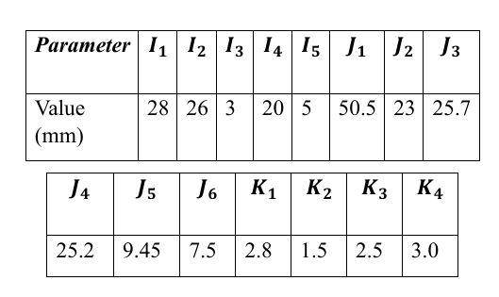











Proposed Design
$$I_{1}$$
$$I_{2}$$
$$K_{3}$$
$$K_{2}$$
$$K_{1}$$
$$J_{6}$$
$$K_{1}$$
$$K_{4}$$
$$J_{2}$$
$$J_{1}$$
$$J_{5}$$
$$J_{3}$$
$$J_{4}$$
$$I_{5}$$
$$I_{3}$$
$$I_{4}$$

Slide 15
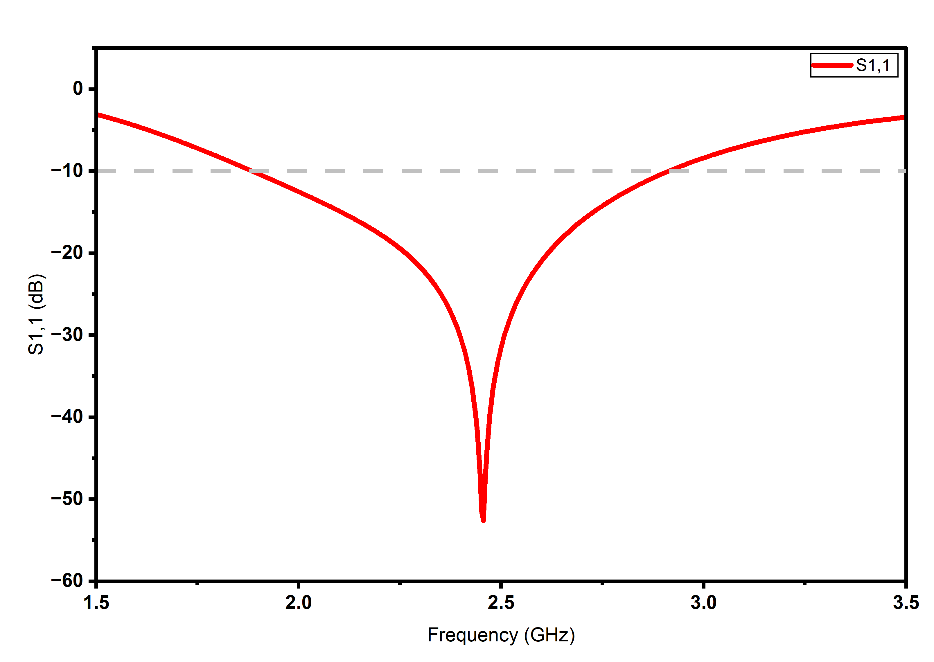
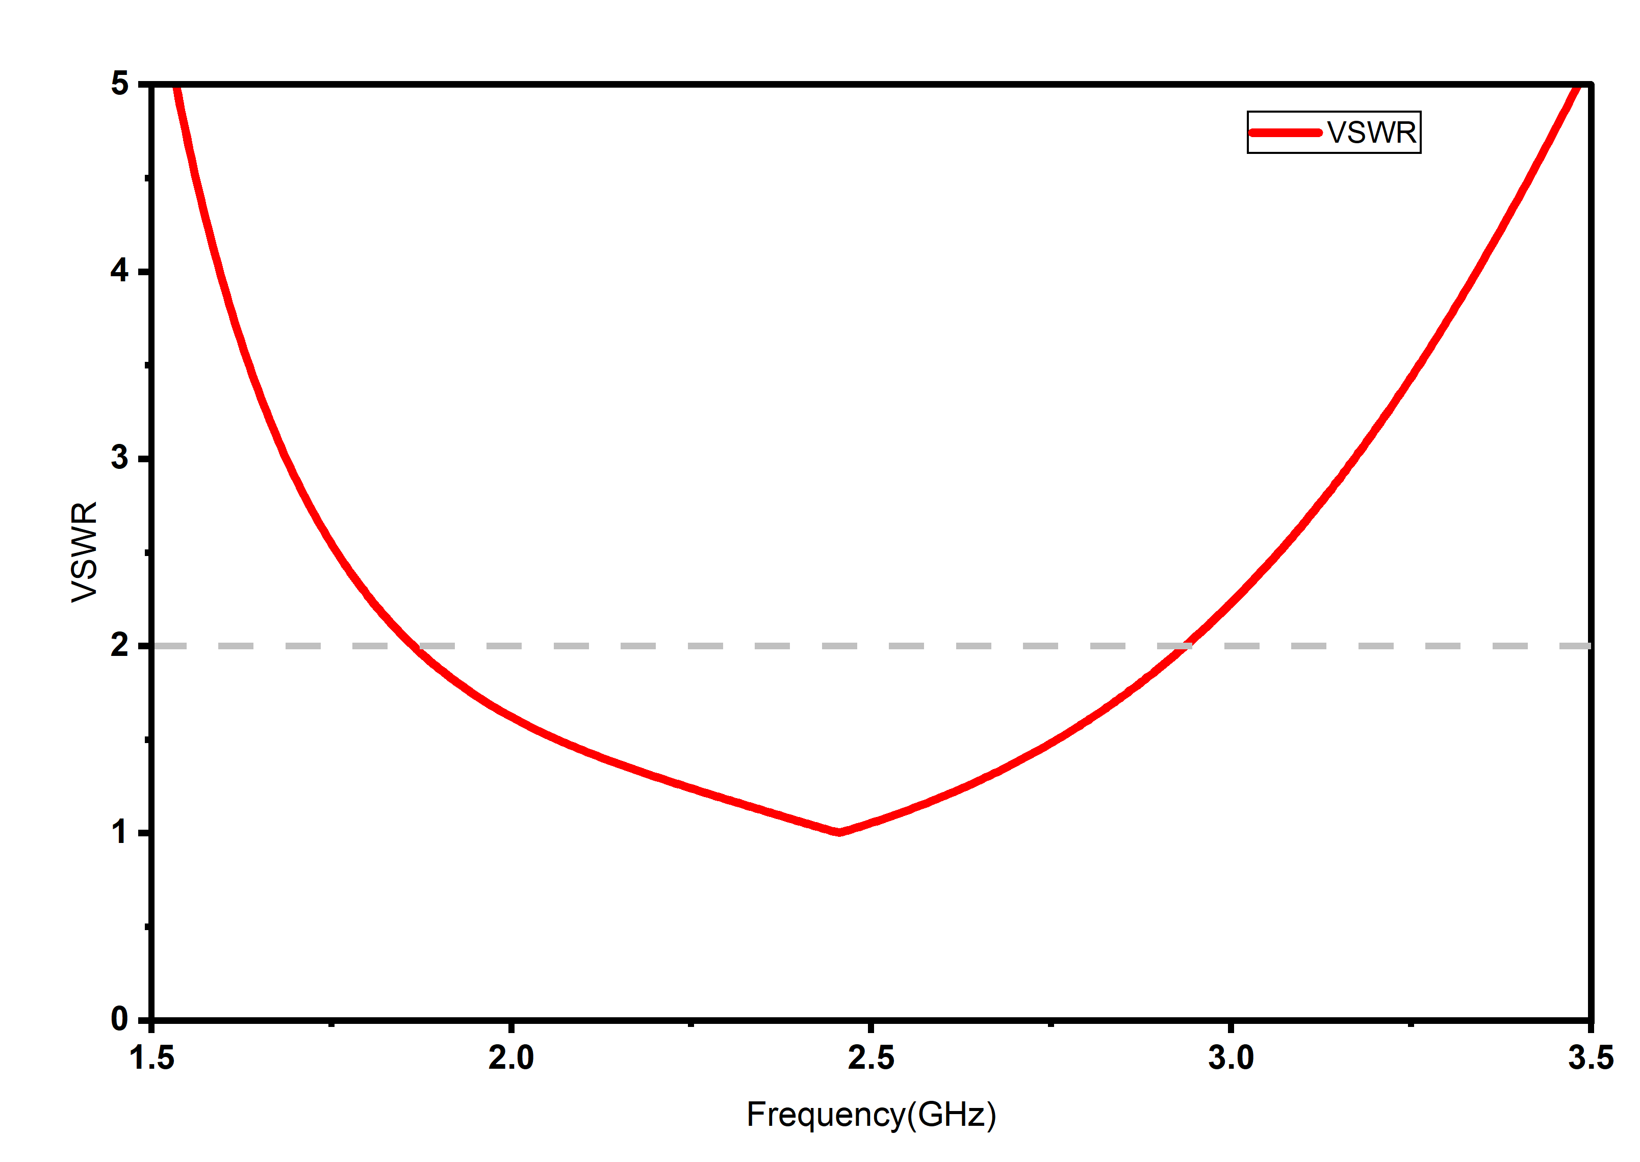
S11 Parameter and VSWR

Slide 16
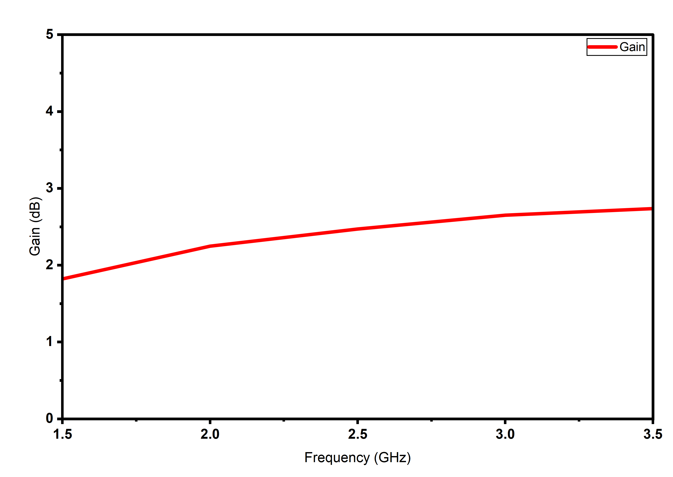
Gain without FSS

Slide 17
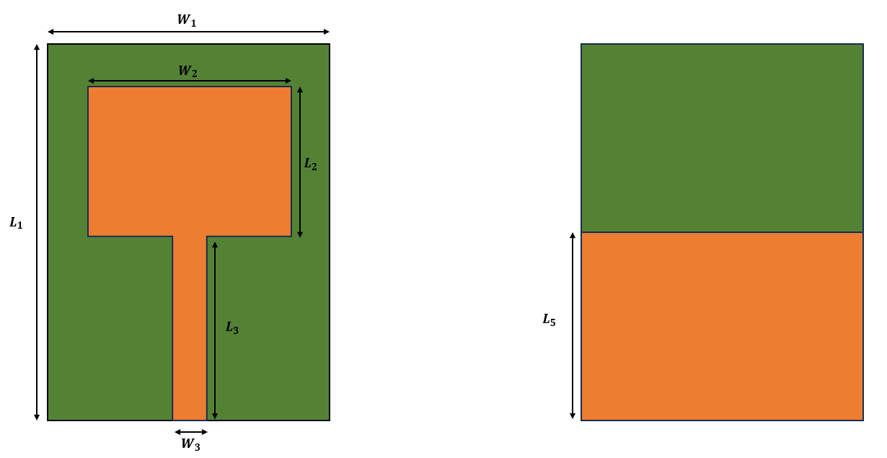
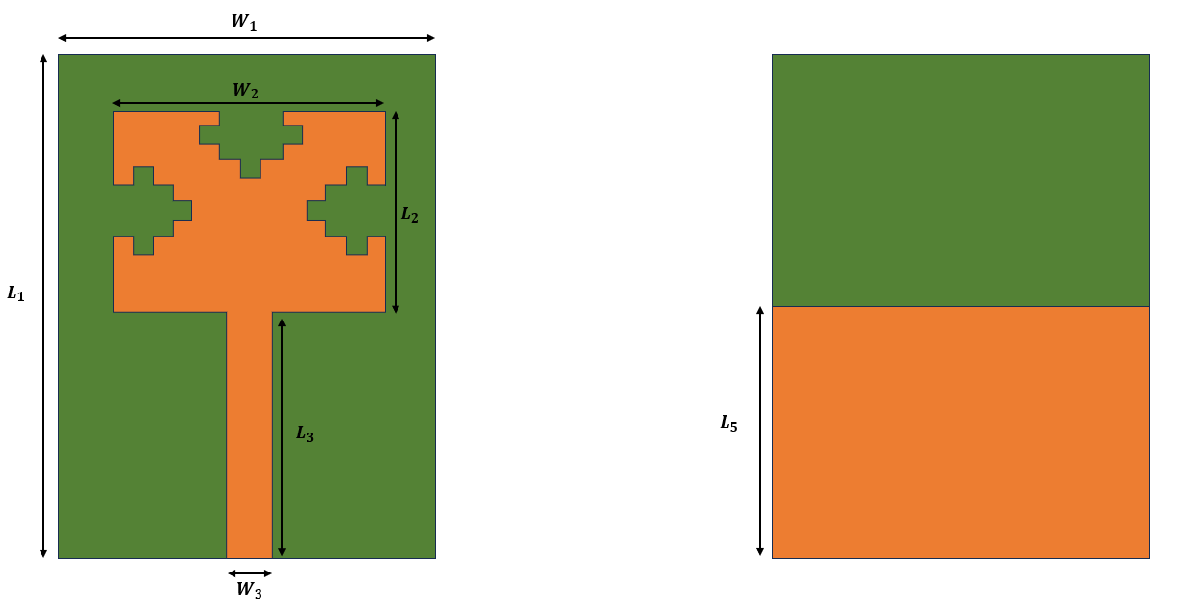
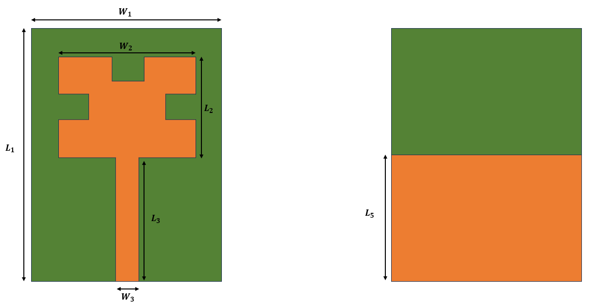
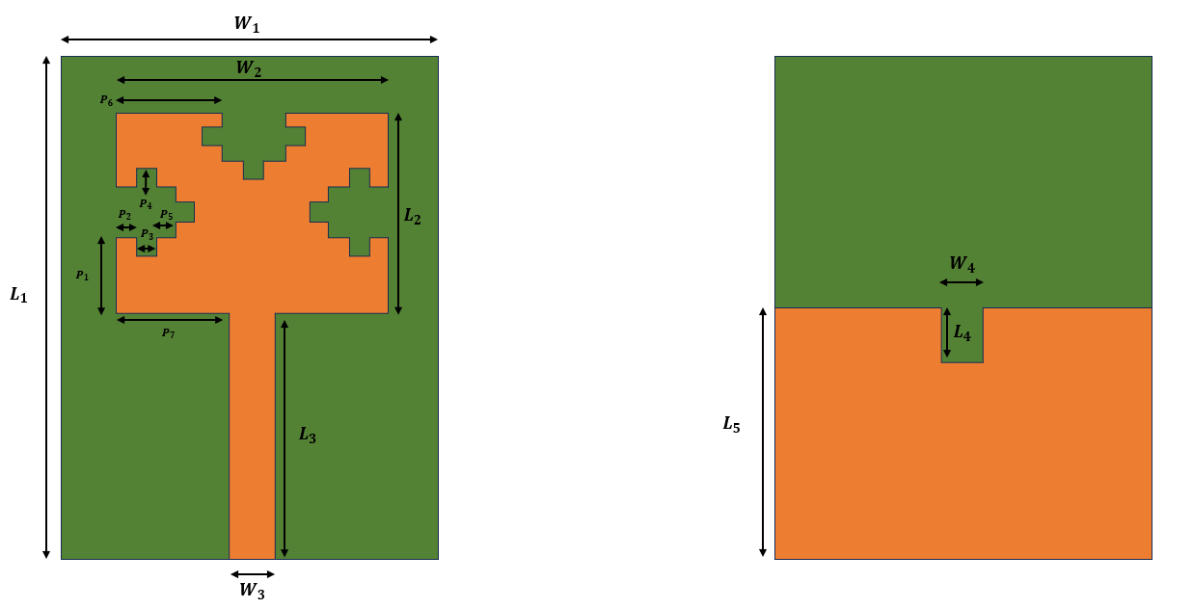
Stage-Wise Designs
Stage 3
Stage 1
Stage 2
Stage 4

Slide 18
Parameter | Value(in mm)
W1 | 38
W2 | 26
W3 | 3.8
W4 | 4
L1 | 50.5
L2 | 23
L3 | 25.7
L4 | 6.45
L5 | 25.2
P1 | 8.6
P2 | 1.5
P3 | 2.5
P4 | 2.5
P5 | 1.5
P6 | 10
P7 | 11.1

Slide 19
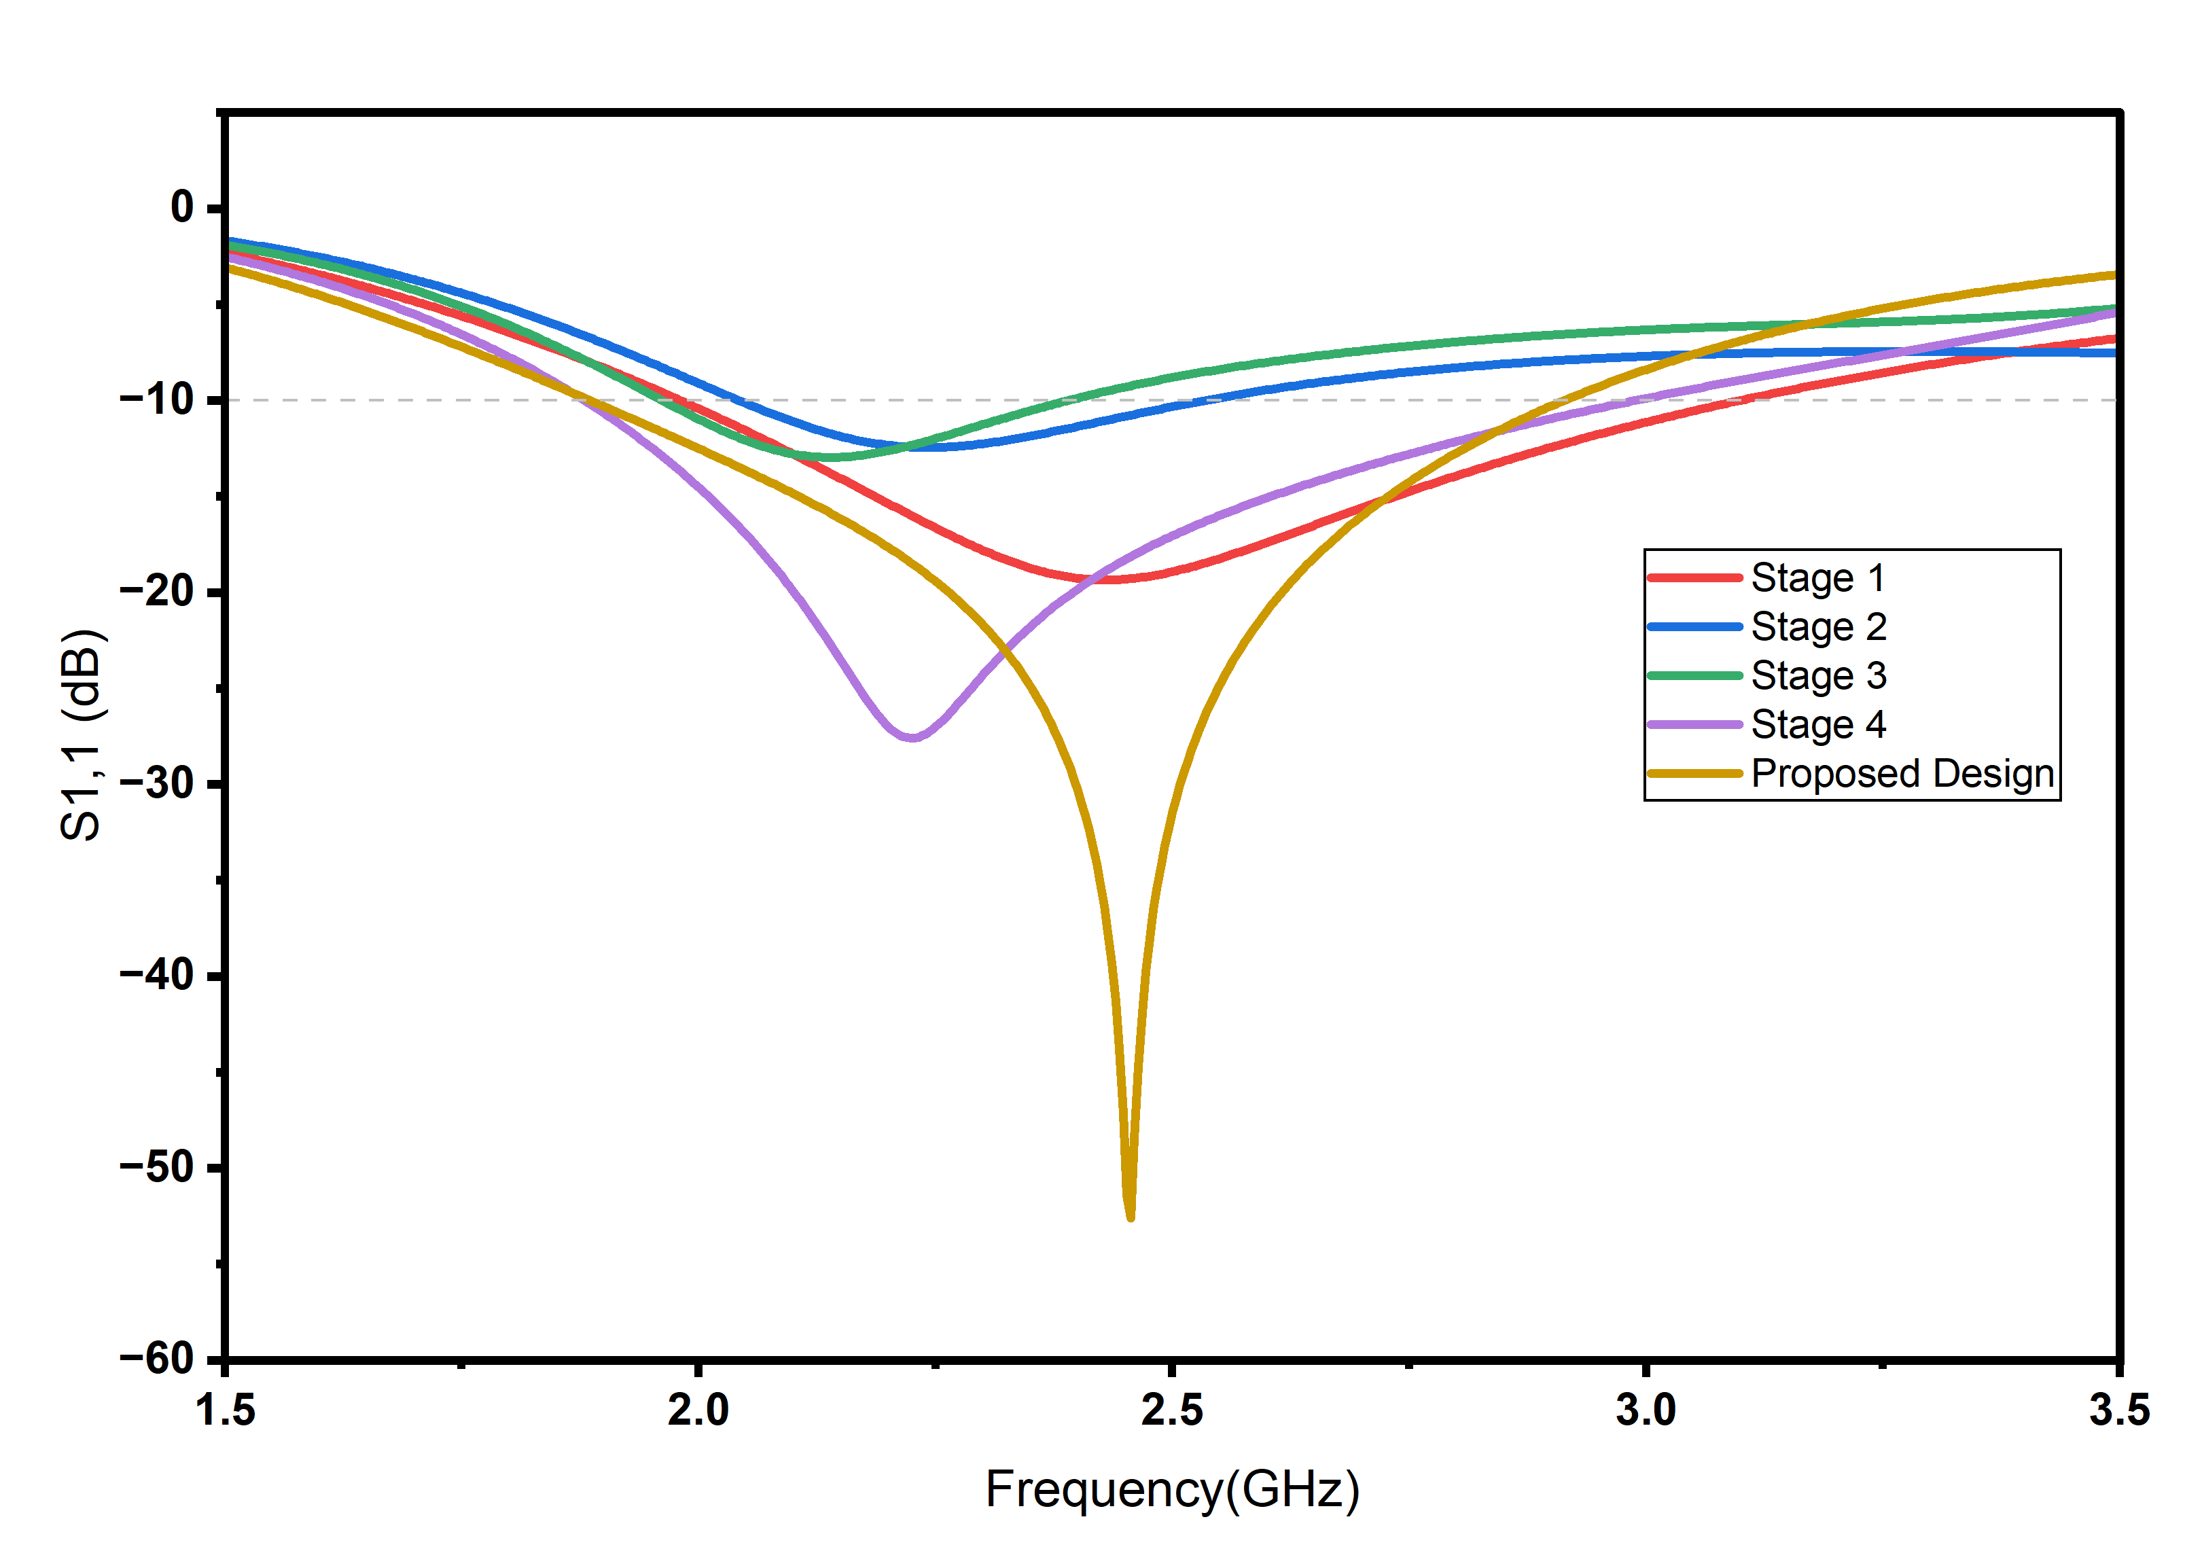
S11 Parameter Results

Slide 20
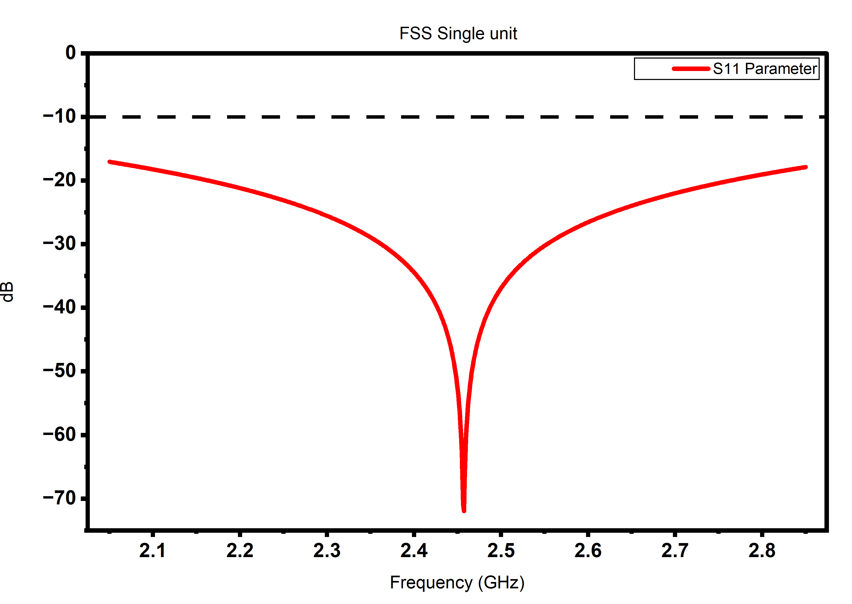







FSS Unit
$$D_{x}$$
Parameter | Value (in mm)
Dx | 40
Dy | 40
Da | 4.49
Db | 4.785
Dr | 15.525
Dl | 9.06
Dw | 2.59
g | 0.865
$$D_{b}$$
$$D_{a}$$
$$D_{r}$$
$$D_{y}$$
$$D_{l}$$
$$D_{w}$$
g
S11 Parameter

Slide 21



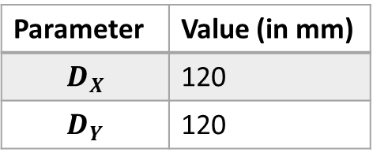
FSS 3x3
$$D_{X}$$
Parameter | Value (in mm)
$$D_{X}$$ | 120
$$D_{Y}$$ | 120
$$D_{Y}$$
S11 Parameter

Slide 22
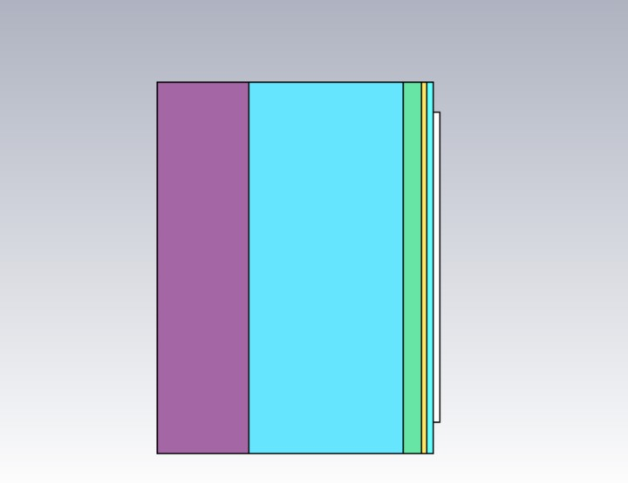
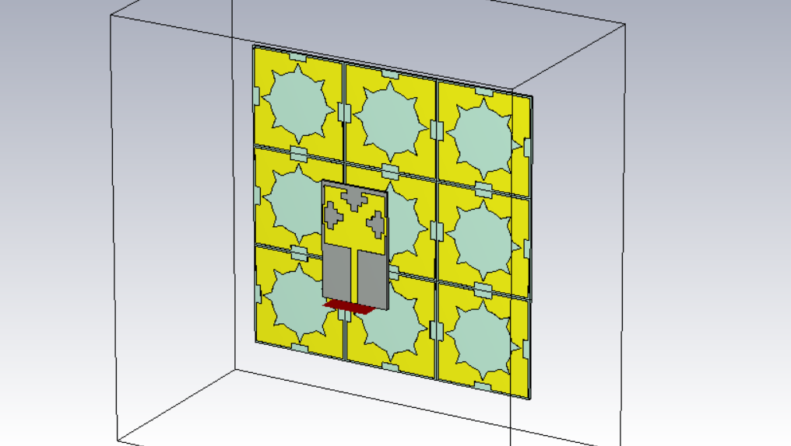
SAR Phantom
Air
Antenna with FSS
Bone
Muscle
Fat
Skin

Slide 23
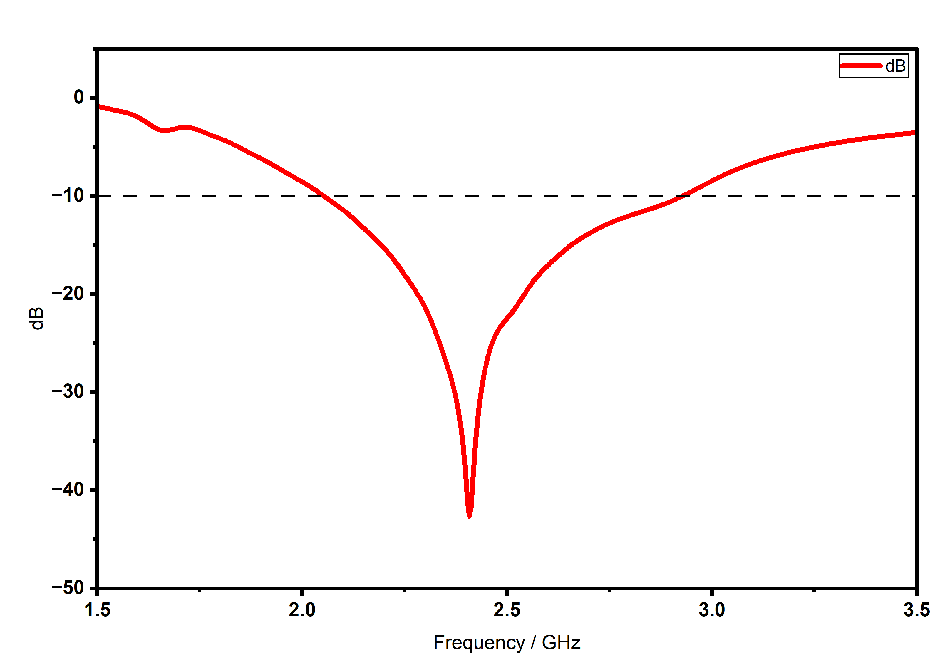
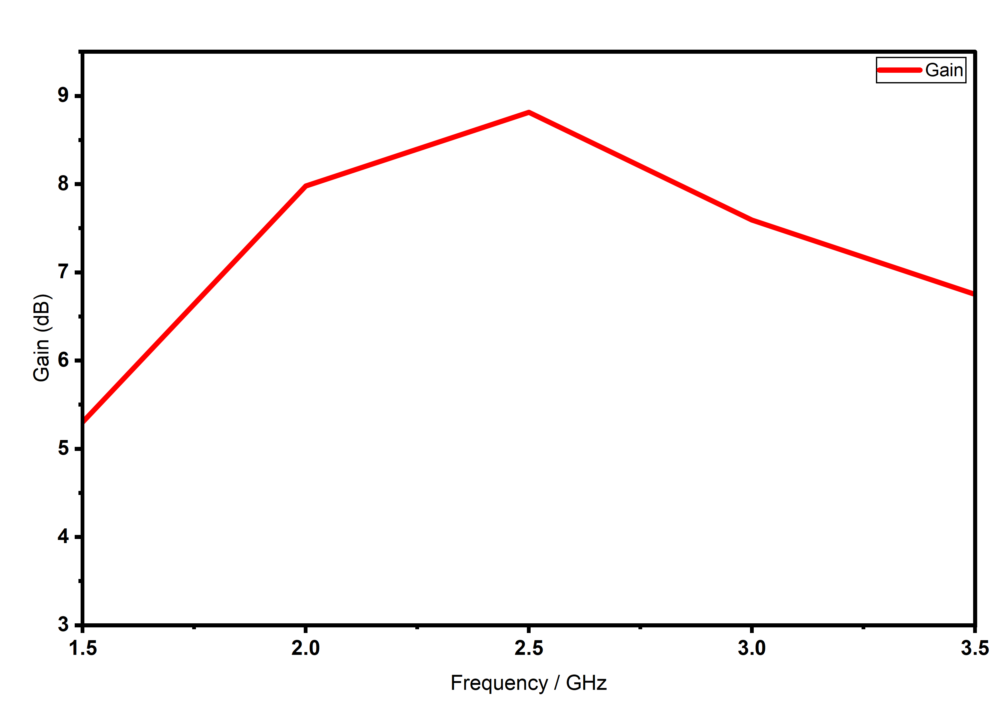
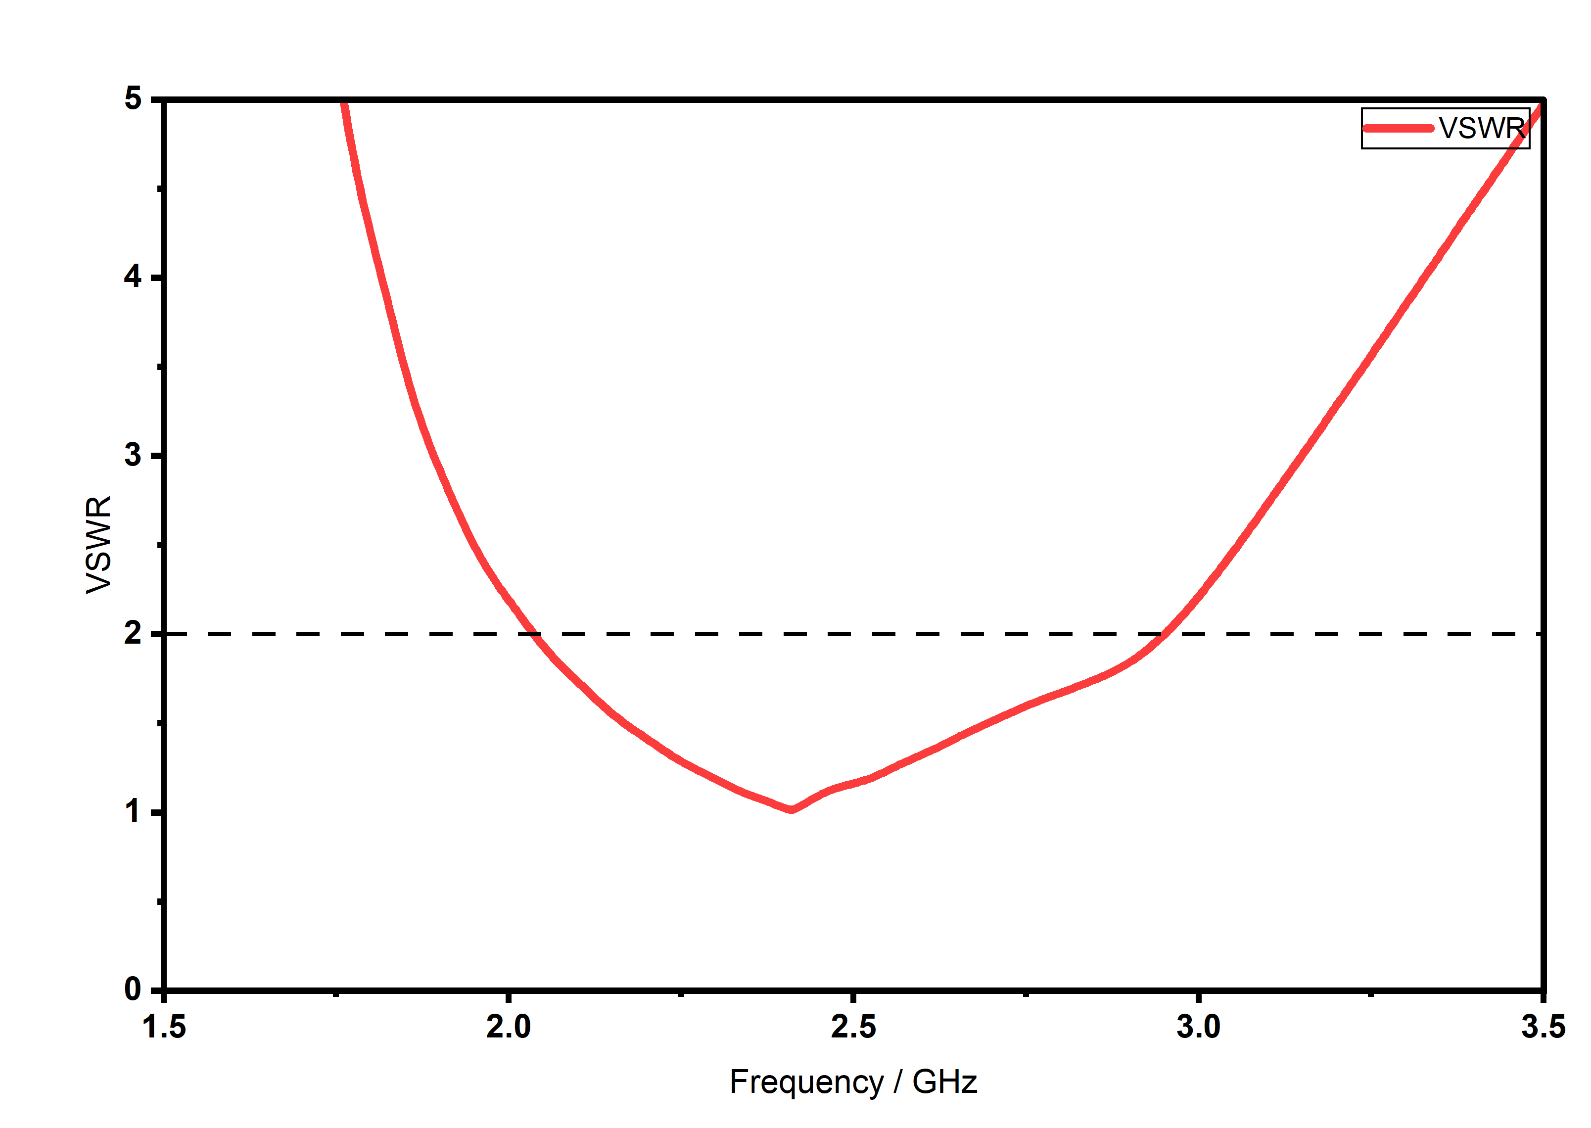
Antenna with FSS
S11 Parameter
Gain
VSWR

Slide 24
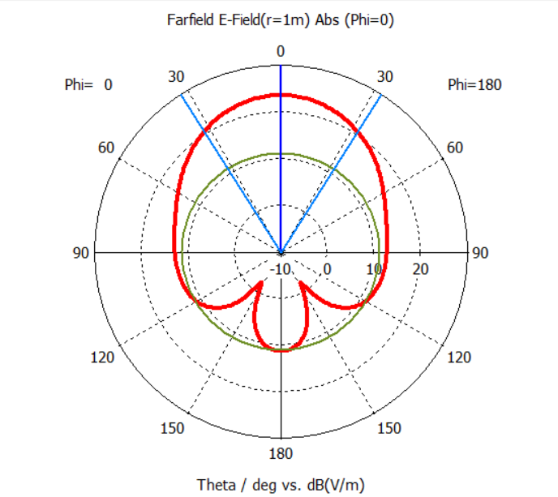
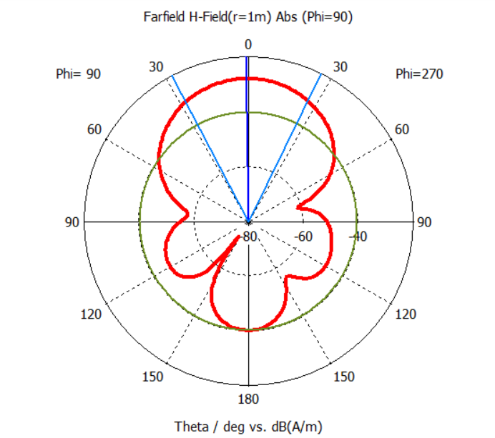
Radiation Patterns
E-Field
H-Field

Slide 25
Future Scope
Antenna Miniaturization Reduce overall antenna and FSS size for compact, wearable applications
Flexible & Textile Materials Implement on flexible or fabric substrates to improve comfort and usability
Multi-band / Wideband Design Extend operation to support Wi-Fi, Bluetooth, and IoT frequency bands
Advanced EM Structures Explore AMC and metamaterials for improved gain and further SAR reduction

Slide 26
Experimental Validation Fabricate and test using VNA and anechoic chamber to verify simulation results
Real-world Integration Incorporate into wearable health monitoring and WBAN systems
System-Level Optimization Enhance compatibility with medical IoT devices and real-time data transmission

Slide 27
Results
Operating Frequency Designed for 2.45 GHz ISM band (WBAN applications)
Impedance Matching Achieved stable resonance with excellent return loss (S₁₁)
Gain Improvement
Without FSS: 2.3 dBi
With 3×3 FSS: 8.65 dBi → ~276% increase in gain
SAR Reduction
Without FSS: 13.4 W/kg
With FSS: 0.47 W/kg → ~96.5% reduction in SAR

Slide 28
Conclusion
Successfully designed a compact WBAN antenna operating at 2.45 GHz
Integration of 3×3 FSS effectively:
Suppresses back radiation
Enhances forward radiation
Achieved high gain + low SAR simultaneously, which is critical for wearable systems
Proposed design is a safe, efficient, and practical solution for:
Wireless Body Area Networks (WBAN)
Wearable healthcare devices

Slide 29
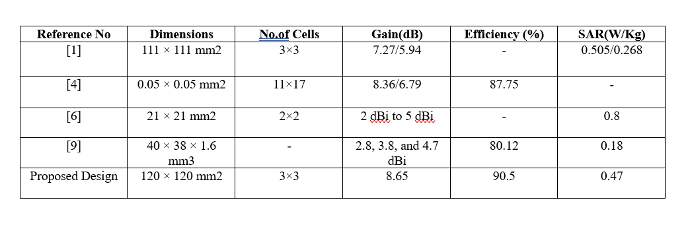
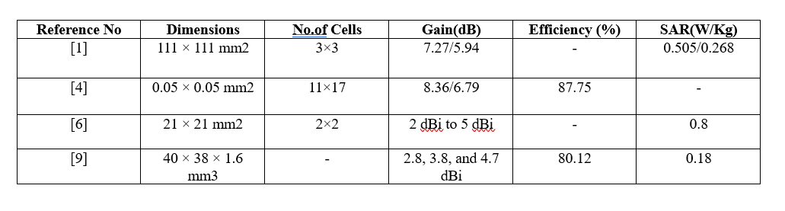
Comparison Table

Slide 30
References
[1] Yotrawee Hengroemyat, Wanwisa Thaiwirot, Prayoot Akkaraekthalin, Akkarat Boonpoonga and Nonchanutt Chudpooti, “Dual-band textile AMC integrated monopole antenna for SAR reduction,” EURASIP Journal on Wireless Communications and Networking, vol. 2026:28, 2026. https://doi.org/10.1186/s13638-026-02576-y
[2] Archana Mohan and Niraj Kumar, “Compact wideband implantable antenna for wireless capsule endoscopy application in the 2.45 GHz ISM band,” Scientific Reports, vol. 15, 2025. https://doi.org/10.1038/s41598 025-15591-8
[3] Sunaina Singh, Ranjan Mishra, Ankush Kapoor and Soni Singh, “A Comprehensive Review and Analysis of the Design Aspects, Structure, and Applications of Flexible Wearable Antennas,” Telecom, vol. 6, no. 1, 2025. https://doi.org/10.3390/telecom6010003
[4] Youssef Amraoui, Imane Halkhams, Rachid El Alami, Mohammed Ouazzani Jamil and Hassan Qjidaa, “Terahertz dual-band antenna design with improved performances using FSS-based metasurface concept for wireless applications,” Scientific African, https://doi.org/10.1016/j.sciaf.2025.e02566

Slide 31
[5] Kummaramsetty Sainath, Shine Let Gunamony, Wahaj Abbas Awan, Navin M. George, Majjiga Deva Sindhu, Fahad N. Alsunaydih and Khaled Alhassoon, “Development of flexible durable multi-slotted antenna for wearable applications,” Heliyon, vol. 10, 2024. https://doi.org/10.1016/j.heliyon.2024.e40627 [6] Biragathis Babu, DiviyaDevi Paramasivam, Raimi Dewan, Noor Asmawati Samsuri and Nazirah Othman, “On-Body Reduced Size AMC Design for Lowering Specific Absorption Rate in Wearable Antenna Application,” Journal of Medical Devices Technology, vol. 3, no. 1, 2024. https://jmeditec.utm.my [7] Mahmoud A. Abdelghany, Mohamed I. Ahmed, Ahmed A. Ibrahim, Arpan Desai and Mai F. Ahmed, “Textile Antenna with Dual Bands and SAR Measurements for Wearable Communication,” Electronics, vol. 13, 2024. https://doi.org/10.3390/electronics13122251 [8] Mahmoud A. Abdelghany, Mohamed I. Ahmed, Ahmed A. Ibrahim, Arpan Desai and Mai F. Ahmed, “Textile Antenna with Dual Bands and SAR Measurements for Wearable Communication,” Electronics, vol. 13, 2024. https://doi.org/10.3390/electronics13122251

Slide 32
[9] Hesham A. El-Hakim and Hesham A. Mohamed, “Engineering planar antenna using geometry arrangements for wireless communications and satellite applications,” Scientific vol. 13, Reports, https://doi.org/10.1038/s41598-023-46400-9 [10] . Yang Xiao, Haoran Zu, Rongguo Song, Yitong Xin, Yueyue Xi, Guan Long Huang, Bian Wu and Daping He, “Multiband and Low-Specific Absorption-Rate Wearable Antenna With Low Profile Based on Highly Conductive Graphene Assembled Film,” IEEE Antennas and Wireless Propagation 2023. Letters, vol. 22, no. 9, 2023. https://doi.org/10.1109/LAWP.2023.3281395 [11] Xi Liang Chang, Pei Song Chee, Eng Hock Lim, “Compact conformal tattoo-polymer antenna for on-body wireless power transfer,” Scientific Reports, vol. 13, 2023, https://doi.org/10.1038/s41598-023-36335-6 [12] 12. Ahmed A. Ibrahim, Hesham A. Mohamed, Mahmoud A. Abdelghany, Emad Tammam, “Flexible and frequency reconfigurable CPW-fed monopole antenna with frequency selective surface for IoT applications,” Scientific Reports, vol. 13, 2023, https://doi.org/10.1038/s41598-023-34917-y

Slide 33
[13] Ayman Ayd R. Saad, Walaa M. Hassan, Ahmed A. Ibrahim, “A monopole antenna with cotton fabric material for wearable applications,” Scientific Reports, vol. 13, 2023, https://doi.org/10.1038/s41598-023-34394-3 [14] Umar Musa, Shahraf Mhd Shah, Huda A. Majid, Ismail Ahmed Mahadi, Mohamad Kamal A. Rahim, Muhammad Saad Yahya, “Design and Analysis of a Compact Dual-Band Wearable Antenna for WBAN Applications,” IEEE Access, vol. 11, 2023, https://doi.org/10.1109/ACCESS.2023.3262290 [15] Musa Hussain, Md. Abu Sufian, Mohammed S. Alzaidi, Syeda Iffat Naqvi, Niamat Hussain, Dalia H. Elkamchouchi, Mohamed Fathy Abo Sree, Sara Yehia Abdel Fatah, “Bandwidth and Gain Enhancement of a CPW Antenna Using Frequency Selective Surface for UWB Applications,” Micromachines, vol. 14, 2023, https://doi.org/10.3390/mi14030591 [16] 16. Iftikhar Ud Din, Waheed Ullah, Nisar Ahmad Abbasi, Sadiq Ullah, Waleed Shihzad, Bilawal Khan, Dushantha Nalin K. Jayakody, “A Novel Compact Ultra-Wideband Frequency-Selective Surface-Based Antenna for Gain Enhancement Applications,” Journal of Electromagnetic Engineering and Science, vol. 23, no. 2, 2023, https://doi.org/10.26866/jees.2023.2.r.159

Slide 34
[17] Hüseyin Şerif Savcı, Fatih Kaburcuk, “FDTD-based SAR calculation of a wearable antenna for wireless body area network devices,” International Journal of Microwave and Wireless Technologies, 2023, https://doi.org/10.1017/S1759078722001283 [18] Devendra Kumar, Dhirendra Mathur, “A Soft Surface Based Low Profile Wearable Antenna for Biomedical Telemetry,” International Journal of Electrical and Electronic Engineering & Telecommunications, vol. 11, no. 5, 2022, https://doi.org/10.18178/ijeetc.11.5.356-362 [19] VSD Rekha, M. Padmanabharaju, B. T. P. Madhav, S. S. Mohan Reddy, “Triple Band Textile Array Antenna with Enhanced Gain and Low SAR for Off Body Communication Applications,” International Journal on Recent and Innovation Trends in Computing and Communication, vol. 10, no. 6, June 2022, https://doi.org/10.17762/ijritcc.v10i6.5626 [20] 20. M. M. Hasan Mahfuz, Md Rafiqul Islam, Chen-Wang Park, Eklas H. A. Elsheikh, F. M. Sadeque, Mohamed Hediati, “Wearable Textile Patch Antenna: Challenges and Future Directions,” IEEE Access, vol. 10, pp. 38426–38427, 2022, https://doi.org/10.1109/ACCESS.2022.3161564

Slide 35
Thank You

